Slide 1
DATA SCIENCE CAPSTONE
Income Drivers and Fairness on the
UCI Adult Census data
Data preparation and EDA milestone
Erik Herb
UCI Adult Census Income · 1994 U.S. Census · Feature drivers and model fairness
Notes:
Quick intro. My capstone is a binary income classifier on the UCI Adult Census data: predicting whether a person earns more or less than 50 thousand a year. This milestone was the data setup and exploration part, so that's what I'll walk through, and then where I'm headed next.

Slide 2
01 BACKGROUND
Problem context
The data comes from the 1994 U.S. Census. The task is to predict whether a person earns more than $50K a year from their demographic, education, and job info through binary classification.
Find which features drive the model decision, and whether it works equally well across groups, and how well different models can differentiate between different income classes.
The goal
Find which features actually drive the >50K prediction, whether the model is fair across groups, and which model is better are distinguishing between classes.
UCI Adult Census Income · Data Science Capstone
02 / 09
Notes:
The data is from the 1994 Census and the target is whether someone makes more than 50 thousand a year. I picked it because income prediction is a classic classification task that maps onto real decisions like lending and hiring, and because it's clean and public, so it's easy to build and compare models on it.

Slide 3
02 DATASET
The data
Source: UCI Adult Census Income, about 15 raw columns.
Target: income, >50K vs <=50K. The classes are imbalanced.
Predictors: age, workclass, education, marital status, occupation, relationship, race, sex, capital gain and loss, hours per week, and native country.
I dropped fnlwgt (a census sampling weight which is the number of people in the actual U.S. population that a given row is meant to represent) and education, which is redundant with education_num.
~32,500
rows, one per person
12
predictors used
24%
earn more than $50K
UCI Adult Census Income · Data Science Capstone
03 / 09
Notes:
About 32 thousand rows, one per person. The target is imbalanced, only about a quarter earn more than 50K, which matters for how I score models.
I kept 12 predictors and dropped two columns: fnlwgt because it's a survey sampling weight, not about the person, and the text education column because it duplicates education_num.
fnlwgt is the number of people in the actual U.S. population that a given row is meant to represent. So a row with fnlwgt of 186061 stands in for roughly 186,000 real people who share similar demographic characteristics.

Slide 4
03 METHOD
Research questions
Three questions drive the project, so the payoff is what the model does and who it works for, not just an accuracy score.
H1: education level drives the >50K prediction more than hours worked. (using coefficients from Logistic Regression)
H2: XGBoost is the fairest of the three models toward true high earners across nativity, with a smaller US-born vs foreign-born recall gap (on real >50K earners) than both Logistic Regression and the MLP
H3: the XGBoost model beats the Logistic Regression baseline and Mulitlayer Perceptron on held-out PR-AUC and F1 score
How I'll test it
Feature importance for H1: coefficients, decision tree importance, permutation importance, and any partial dependencies
Bootstrap 95% Confidence Intervals on each model's US-born vs foreign-born recall gap for H2, then test whether XGBoost's gap is the smallest of the three
McNemar Test on exact same exact test rows for paired predictions for H3 (look for disagreements between models in predictions) and check model p-values to see if one model really is better than another at classification
UCI Adult Census Income · Data Science Capstone
04 / 09
Notes:
The hypothesis is a model comparison: does XGBoost actually beat a logistic baseline on held-out PR-AUC, or is the extra complexity not worth it. Null is that it doesn't beat it. I use PR-AUC instead of accuracy because the classes are imbalanced. I'll test significance with McNemar's and a bootstrap confidence interval on the gap.
On the decision tree: that came from the feedback on my last milestone. It isn't a fourth model competing with the three, it's an interpretability tool. A tree estimates feature importance with every feature competing for the same splits at once, which is what H1 needs and which a one-feature-at-a-time view can't give me. A shallow tree fit on XGBoost's predictions also gives a readable approximation of what the complex model is doing, and that's the explainability note for the final report.
If asked about the tests:
McNemar's test compares two models on the exact same test rows. Because both models predict on the same people, their errors are paired, so I can't treat the mistakes as independent. It builds a 2x2 table of where they agree and disagree and only looks at the two disagreement cells: cases where one model was right and the other was wrong.
The null for McNemar is that those two disagreement counts are equal, meaning neither model is reliably better. A small p-value says one model genuinely beats the other rather than it being luck. That is exactly the H3 question, XGBoost versus the logistic baseline on the same rows, so McNemar belongs to H3.
A bootstrap CI puts an honest margin of error on a number without assuming a clean distribution. I resample the test set with replacement a few thousand times, recompute the metric each time, and take the 2.5th and 97.5th percentiles for a 95 percent interval. The width tells me how stable the number is.

Slide 5
04 PROGRESS
Where I am now
Database
01
Built a SQLite database, loaded the raw data in, then pull it back out with SQL and save a CSV.
Cleaning
02
Filled missing categorical values with "Unknown", dropped 24 exact duplicates, dropped fnlwgt and education.
EDA
03
Summary stats, distribution plots, a correlation heatmap, and income rates broken out by feature.
Status: This milestone (database + EDA) is done. Modeling comes next.
UCI Adult Census Income · Data Science Capstone
05 / 09
Notes:
This is the milestone I just finished. Three things. First, the data lives in a SQLite database now, and everything reads out of that. Second, cleaning: I filled missing values instead of dropping rows, removed 24 real duplicates, and dropped the two columns I mentioned. Third, a full round of EDA. So database and exploration are done, and modeling is the next milestone.

Slide 6
05 FINDINGS
What the data shows
About 76% earn <=50K and 24% earn >50K, so plain accuracy is misleading and I score with PR-AUC.
Education and marital status are strong predictors. The >50K rate climbs steadily with education, and married people are far above never-married.
The >50K rate is much higher for US-born than foreign-born people. That gap is what the fairness audit is built to test.
Education separates the classes more cleanly than hours worked, an early hint toward the first hypothesis question.
UCI Adult Census Income · Data Science Capstone
06 / 09
Notes:
A few takeaways. The target is about 76/24, which is why I don't trust accuracy: always guessing the majority class already gets 76 percent. Education and marital status separate the classes well, and sex, race, and hours worked all carry some signal too. And the numeric features aren't strongly correlated, so no multicollinearity problem.

Slide 7
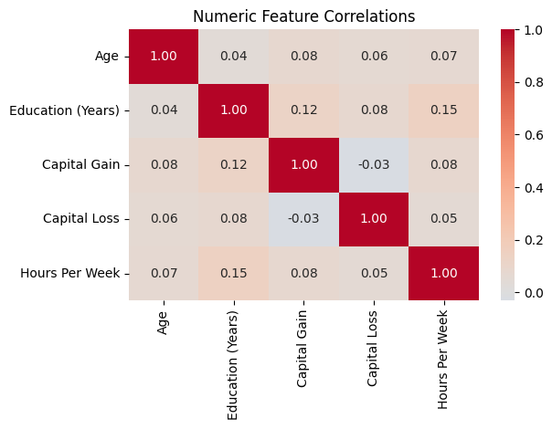
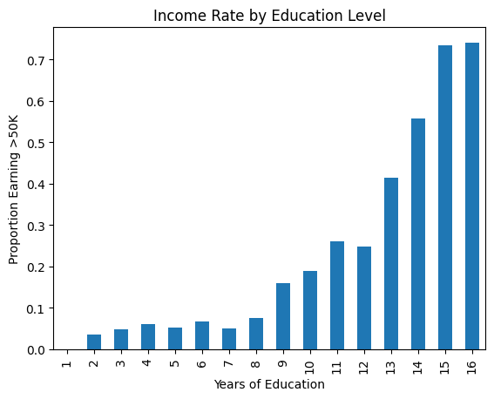
06 EXPLORATORY ANALYSIS
A closer look at the data
FIG. 1 — NUMERIC FEATURE CORRELATION
FIG. 2 — INCOME RATE BY EDUCATION
The numeric features aren't strongly correlated, so none need dropping for multicollinearity.
The >50K rate rises steadily with years of education, a clean signal a model can use.
07 / 09
Notes:
Two of the EDA plots from the notebook. On the right, the share earning more than 50K climbs steadily as education goes up, which is a clean trend even a linear model can use. On the left is the correlation heatmap for the numeric features: the off-diagonal values are all small, so there's no multicollinearity and I don't need to drop any of the numeric features.

Slide 8
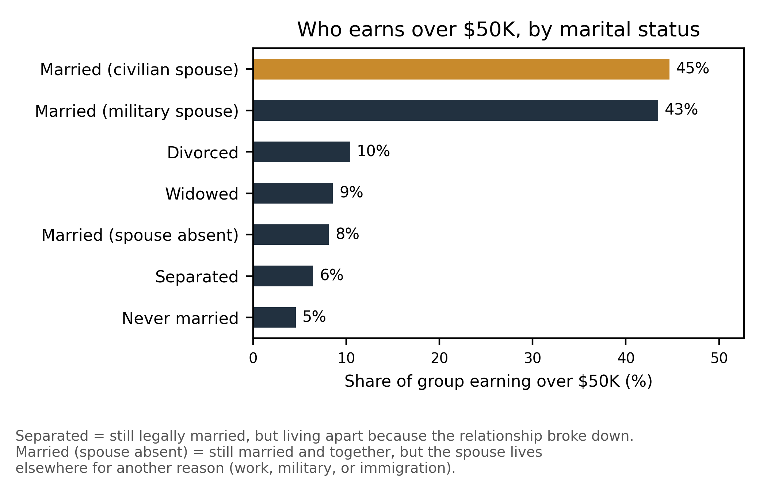
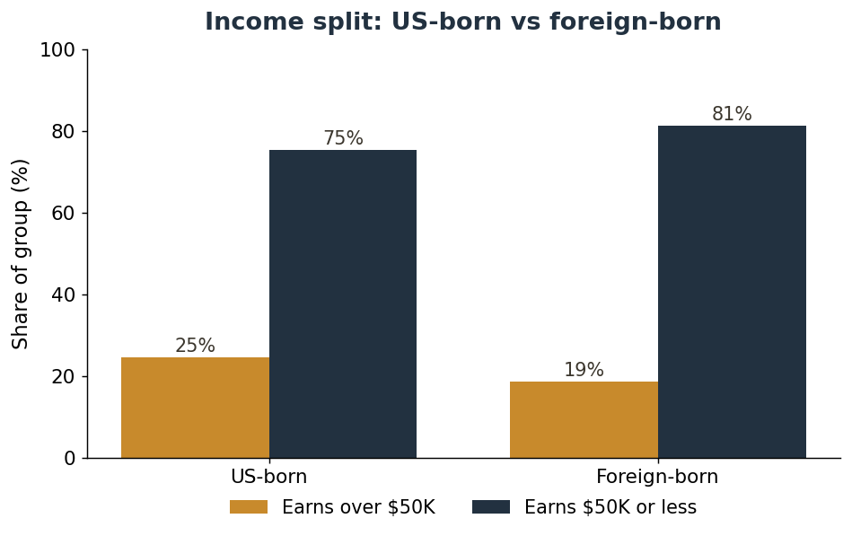
07 EXPLORATORY ANALYSIS
Group differences in income
FIG. 3 — INCOME RATE BY MARITAL STATUS
FIG. 4 — INCOME: US-BORN VS FOREIGN-BORN
Married people are far more likely to earn over $50K than never-married, separated, or divorced people.
US-born people earn over $50K at a higher rate than foreign-born people, the gap the fairness audit tests.
08 / 09
Notes:
Married (spouse absent) – still married and together, but the spouse lives elsewhere (work, military, or immigration)
Separated – still

Slide 9
WHAT'S NEXT
Next steps
01
02
Build and cross-validate the models (Logistic Regression as baseline, XGBoost, and MLP), tune hyperparameters, and handle class imbalance.
Measure which features drive the prediction of who earns >$50K with coefficients using Logistic Regression, permutation importance, and partial dependence (education vs hours worked).
03
04
Run the fairness audit: per-group error rates by nativity, sex, and race, McNemar Test and bootstrap Confidence Intervals, and a fairness-through-unawareness check.
Compare the XGBoost model to the Logistic Regression and MLP on held-out PR-AUC and F1 score, then write up an honest verdict on all three questions.
Thank You! Questions?
09 / 09
Notes:
From here the next milestone is modeling: a majority-class reference, then logistic regression as the baseline, then XGBoost and an MLP, cross-validated and tuned. Then I test whether XGBoost really beats the baseline with McNemar’s Test and a bootstrap confidence interval. And I'll finish the written project plan alongside it. Happy to take questions.

